Slide 1
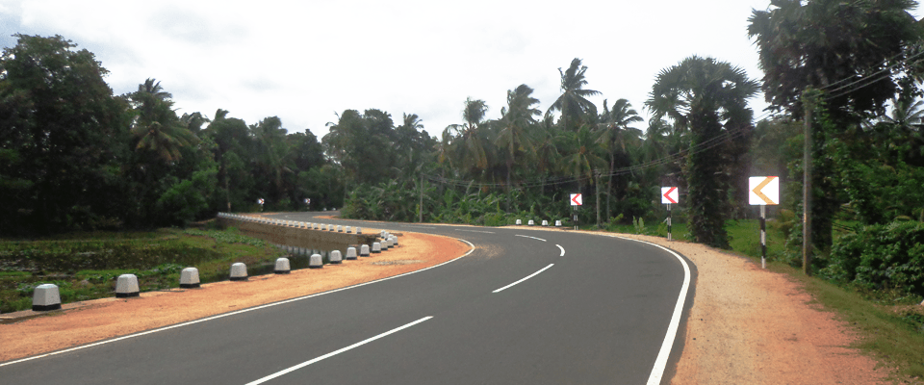
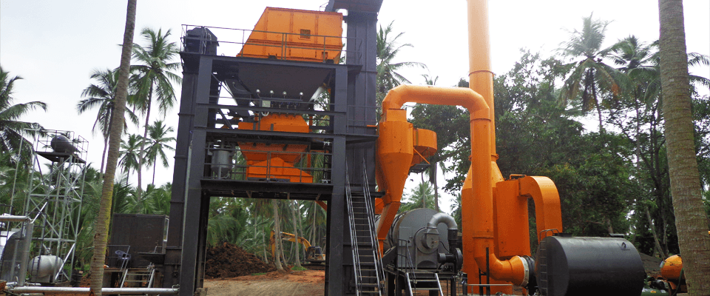
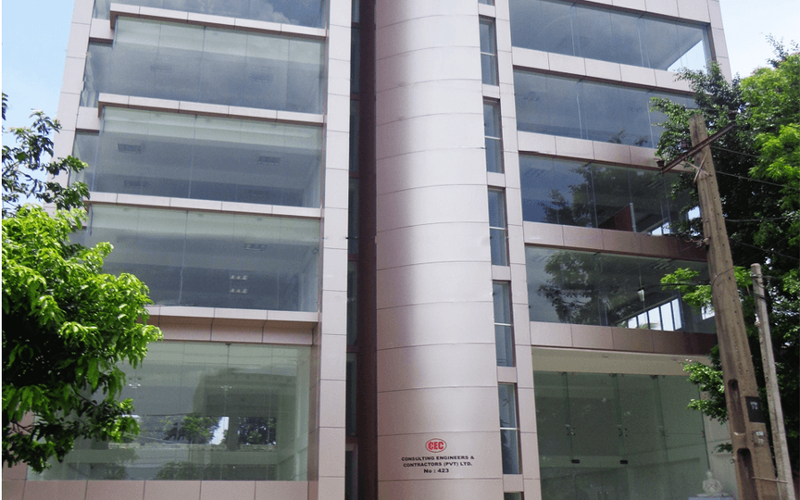
INDUSTRIAL TRAINING
PREMAKUMARA H.P.S.
210494D
Industrial Training Presentation
July 2025
Notes:
Good afternoon.
I’m Premakumara H.P.S., and my index number is 210494D.
This is a summary of my 24-week industrial training, carried out under a road construction project managed by the RDA.

Slide 2
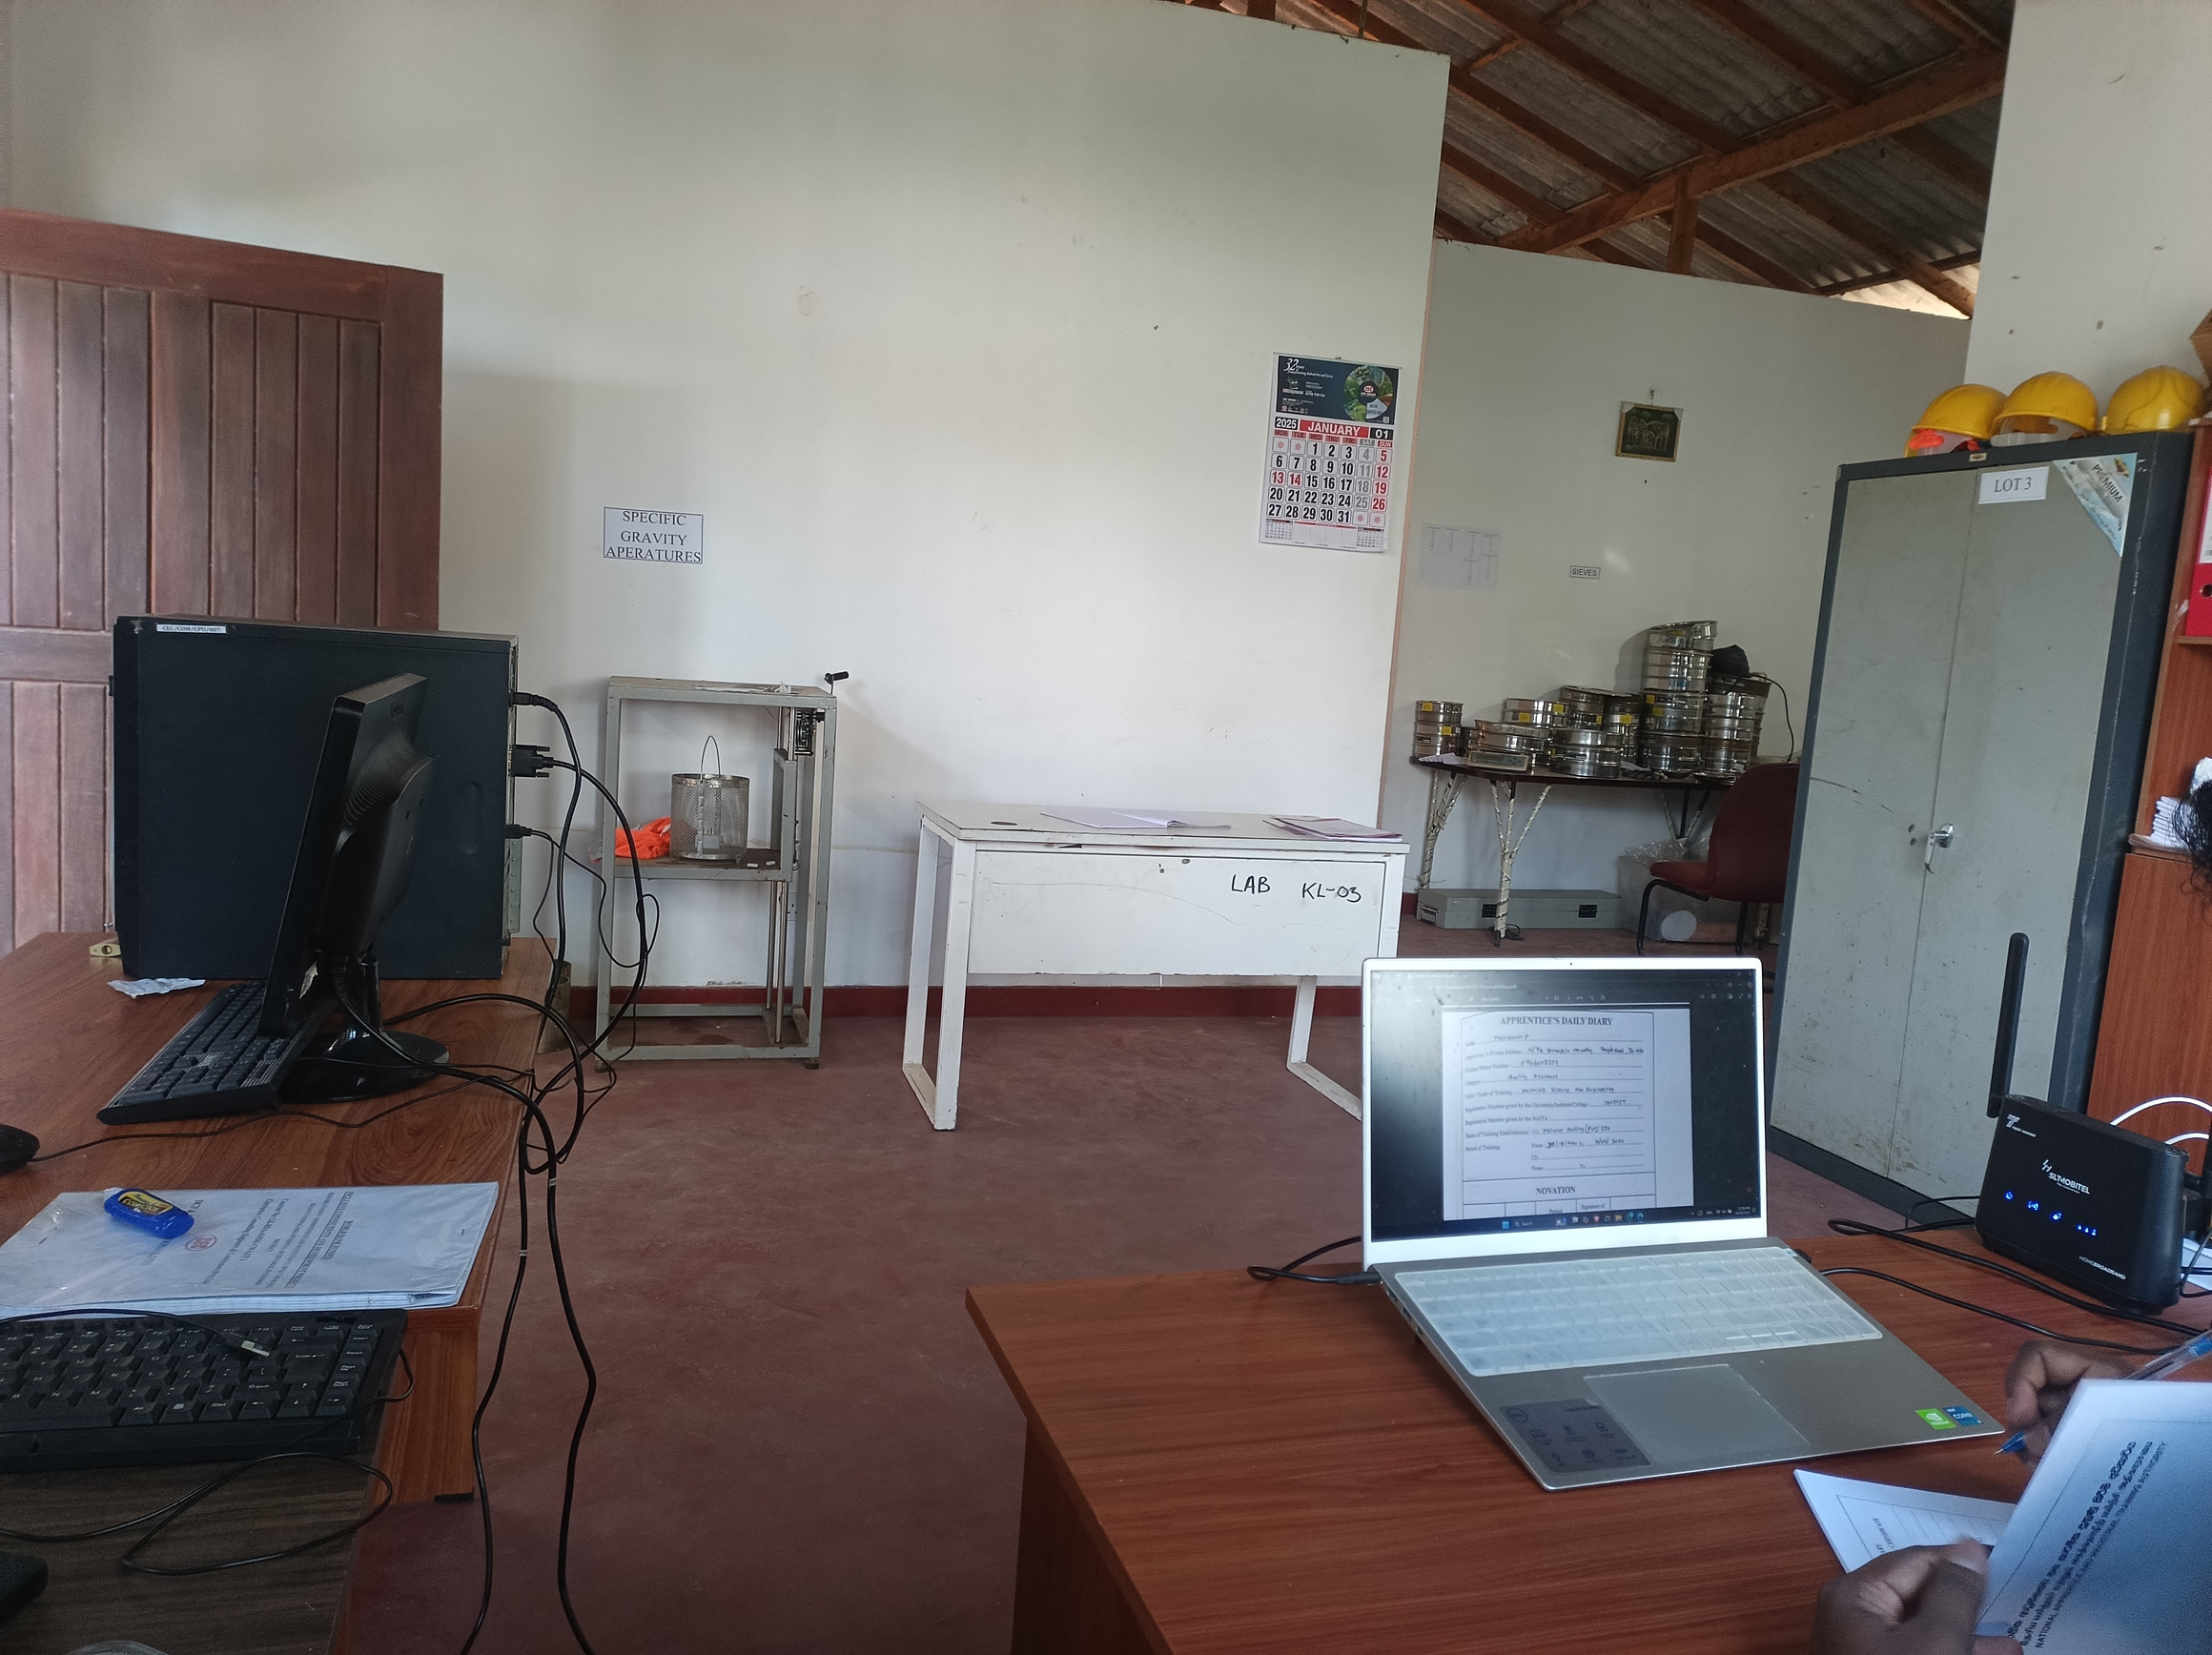



Company & Project Overview
Consulting Engineering And Contractors
(Pvt) Ltd.
Corporate Office
No.423, Nawala Road, Rajagiriya.
Project Office
Uduwana, Homagama.
Project : Road Construction Project
Rehabilitation, improvement, and maintenance of rural roads under the Homagama Divisional Secretariat, Colombo District, Western Province.
Supervisor:
Mr. G.Thanushka
Contacts : +94712493812
Contractor :
Consultant :
Road Development Authority
Euro Group For Engineering Consultants
My Role : Trainee ME
Duration 24 weeks
Standard followed :
ASTM (American standards) , BS (British standards)
Page 2
Notes:
I was assigned to Consulting Engineering & Contractors (Pvt) Ltd.
working on the Rehabilitation and Maintenance of Rural Roads under the Homagama Divisional Secretariat.
We followed standards as ASTM,BS.
Out of five contract packages, our company was awarded four, totaling around LKR 1,700 million, funded by the World Bank.
I worked under Mr. G. Thanushka, based at the Uduwana site office and laboratory, as a Trainee Material Engineer.

Slide 3
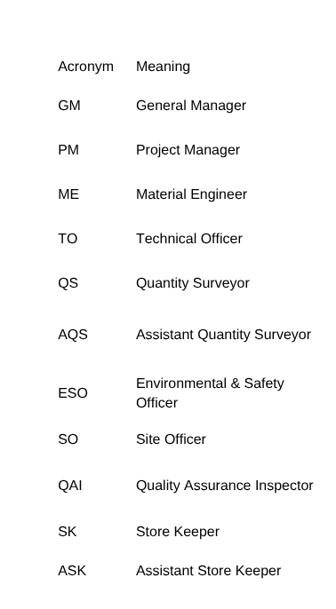
Project Team
Structure
MANAGING DIRECTOR
MANAGING
DIRECTOR
GM
GM
PM
PM
SITE ENGINEER
QS
Draftsman
ME
ESO
Surveyor
HR
Accounts
&
Admin
QAI
SK
SITE
QS
Draftsman
ME
ESO
Surveyor
HR
Accountant
QAI
SK
ENGINEER
and
Admin
SO
ASK
AQS
So
ASK
AQS
Trainee
MT
TO
Trainee
Trainee
MT
Surveyor Helper
Trainee
Survey
Helper
Supervisor
AMT
Supervizor
AM
Lab
Helper
Skilled Labour
Unskilled
Labour
Lab
Skilled
Labor
Helper
Unskilled
Page 3
Labor
Notes:
The team was led by the Managing director, General Manager, and Project Manager.
I worked under the Material Engineer and interacted with other key roles like QAM, Site Engineering, Surveyor, and HR.
This experience helped me understand multi-disciplinary coordination, fulfilling Program Outcomes like teamwork and project management.

Slide 4
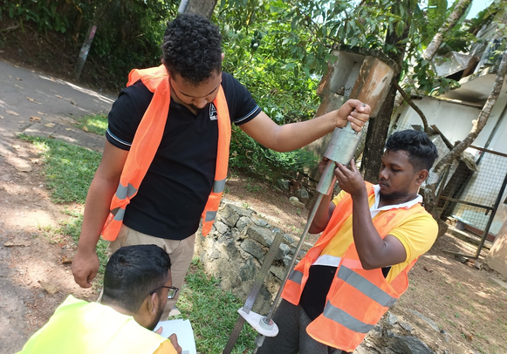
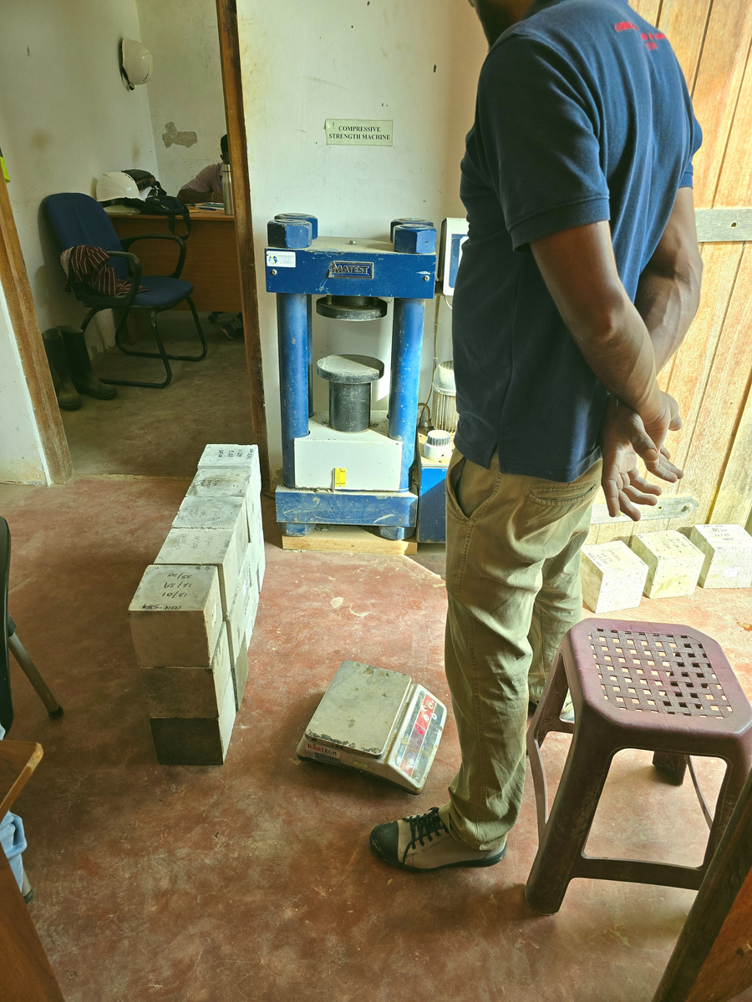
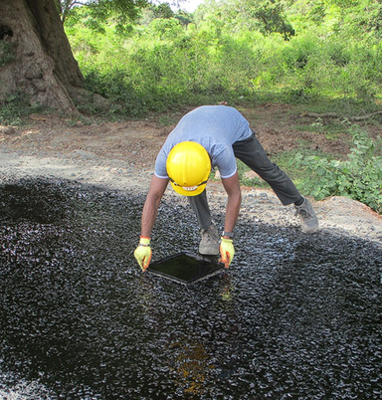
Key Technical Learning
🎯 PO1
🎯 LO1
  Soil & Aggregate Testing
DCP, Proctor, CBR, PI, SA
  Concrete Testing
Slump, Cube test
  Bitumen & Asphalt Testing
Tray test, Marshall Stability, Extraction test
Page 4
Notes:
I gained hands-on experience in:
Soil & Aggregate Testing: DCP, Proctor, CBR, PI, SA
Concrete Testing: Slump and cube strength
Bitumen & Asphalt works: Tray, Marshall, and extraction tests
These tasks reflect POS like Engineering knowledge and Applying materials science in practice.

Slide 5
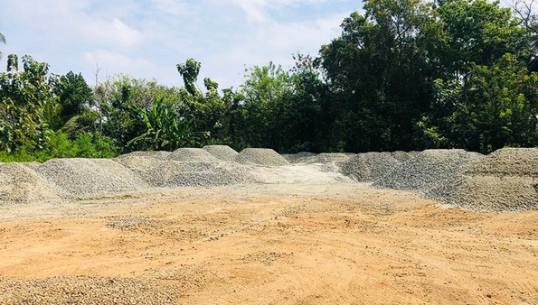
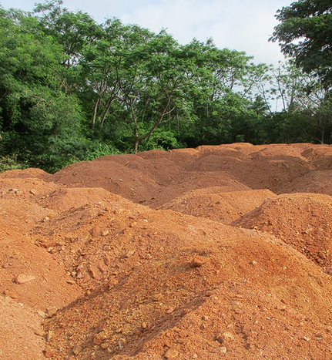
Design & Management
🎯 PO3
🎯 PO7
🎯 LO2
  Designing
Pavement design, Concrete mix design
  Investigation & Impact
Borrow pit investigation & environmental considerations
  Management
Stockpile management like ABC, SB, EMB, Aggregate and SHO and Quality testing
Page 5
Notes:
During the training period I participated in
pavement and mix design,
borrow pit investigations,
stockpile management of ABC, SB, EMB, and SHO materials
And quality testing for sored materials.
These activities developed my understanding of design processes, environmental considerations, and quality testing.

Slide 6
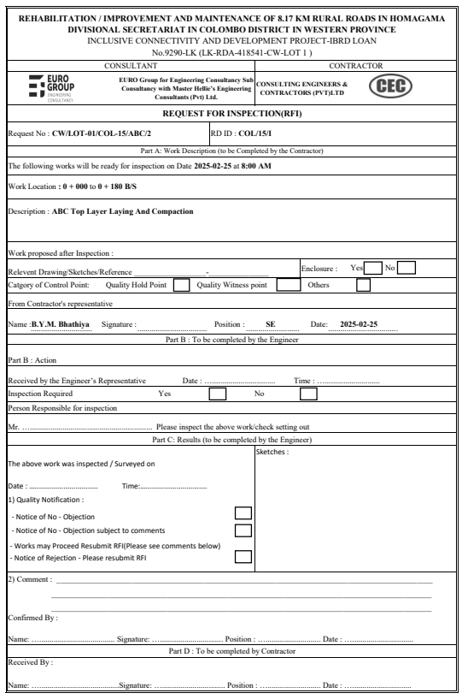
Documentation & QA
🎯PO10
🎯PO11
🎯LO4
  Progress Reports & Inspection
DPR, RFI
  QA documentation standards
ISO 9001
  Automated reporting tools
Developed an Excel-based RFI management tool
Page 6
Notes:
I helped manage Daily Progress Reports (DPR)
fully handled the Request for Inspection (RFI) process for package 1 during my intern period
and followed ISO 9001 standards for QA documentation.
And also developed an Excel-based RFI Manager that automated RFI documenting process.

Slide 7
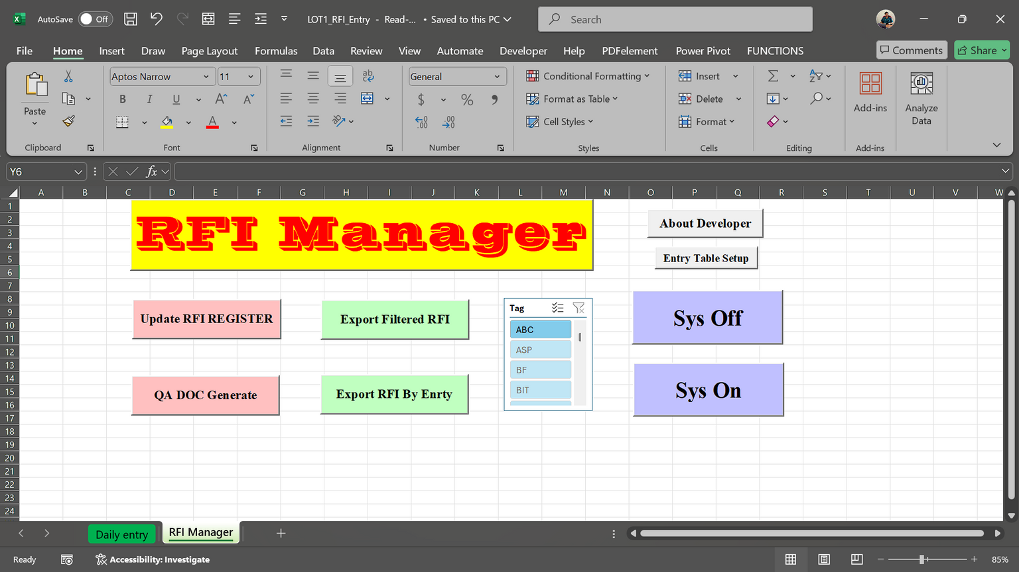
Automated Reporting
Page 7
Notes:
and this help to reduce document processing time and this is the tool interface.
These learnings aligned to Communication, Project coordination, and Managerial practice enhancement.

Slide 8
Automated DCP test report
🎯PO2
🎯PO5
🎯LO4
  Problem
Inefficiency and errors in manual DCP test reporting.
  Solution
Developed an automated Excel tool for DCP test report generation.
Impact: Enhanced accuracy and efficiency, reducing management effort.
Page 8
Notes:
Manual DCP reporting was inefficient and error-prone.
So, I developed an automated DCP report generator based on Excel.

Slide 9
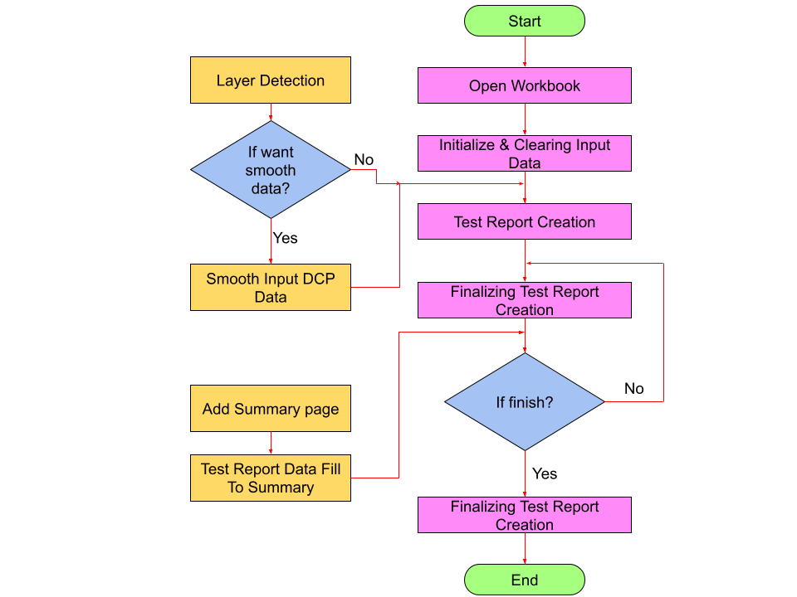
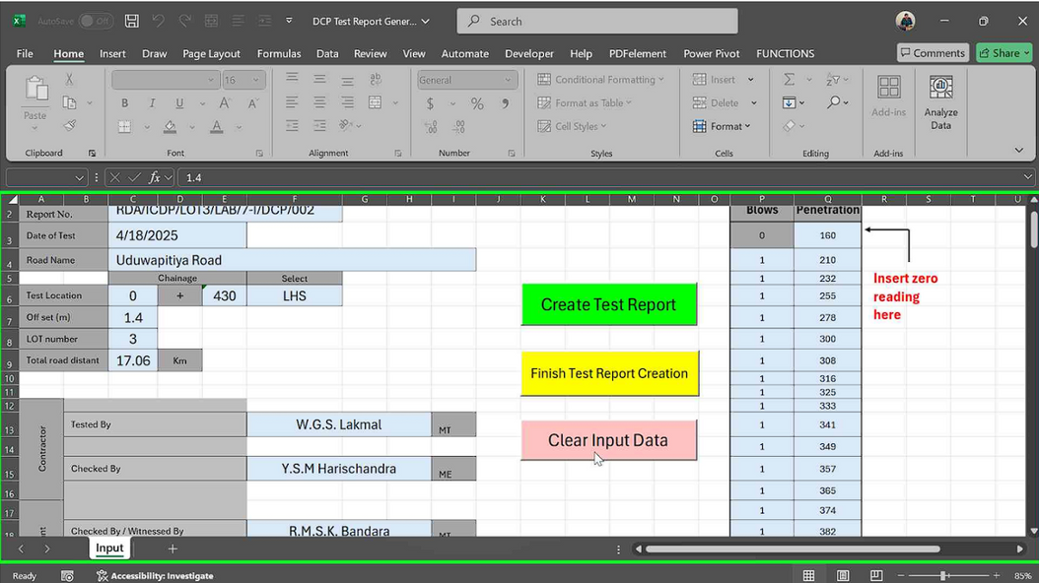

DCP test report generator
Page 9
Notes:
It included input validation, report creation, and summary sheets—all in one tool.
This tool improved accuracy and report creating efficiency, aligning with Problem-solving, Modern tools using.

Slide 10
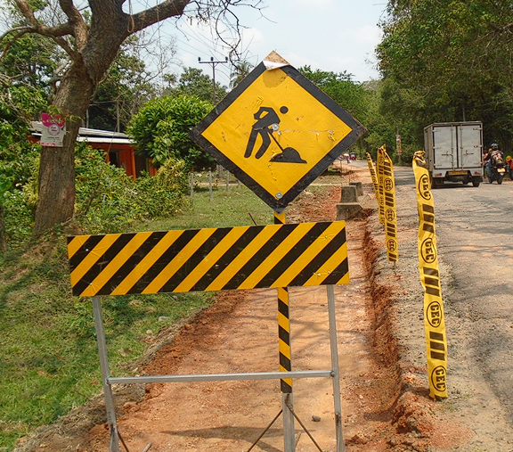
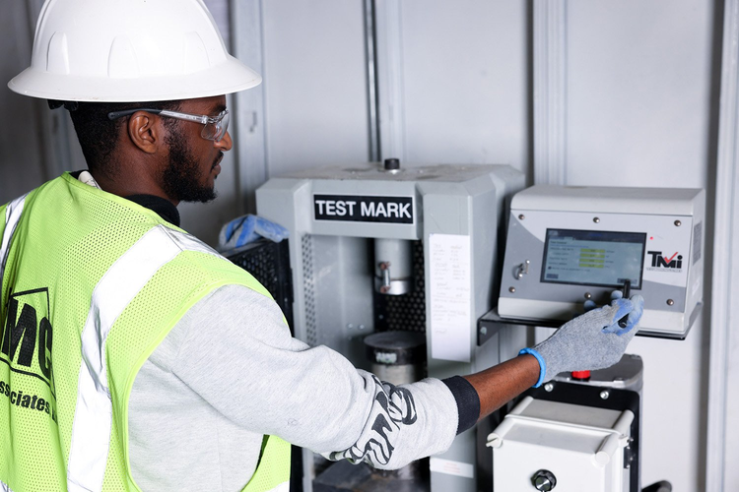
Health, Safety & Environmental Practices
🎯PO6
🎯LO3
  Followed proper safety protocols
During Testing, On site activities
Page 10
Notes:
Safety was a core focus throughout my training.
I followed PPE protocols
During testing
On site activities

Slide 11
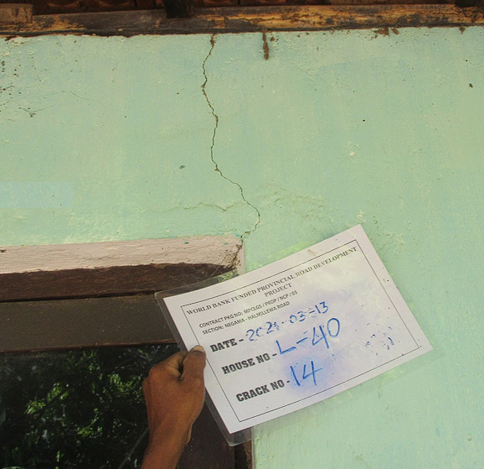
Health, Safety & Environmental Practices
🎯PO6
🎯LO3
  Crack survey
  Environmental parameter monitoring
CO2 , NO2 , Weather condition
Page 11
Notes:
participated in crack surveys,
environmental monitoring (CO₂, NO₂, weather),

Slide 12
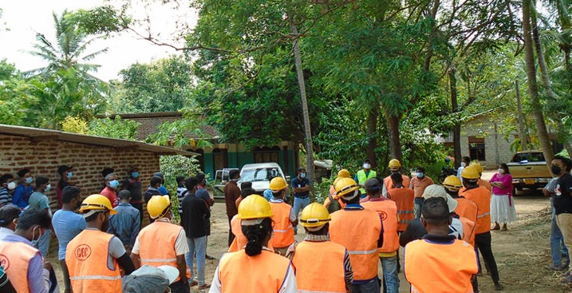
Health, Safety & Environmental Practices
🎯PO6
🎯LO3
  Daily Toolbox Meeting / Safety Briefing
Page 12
Notes:
and daily toolbox meetings.
Usually this conducted by the site engineer or safety officer.
These briefings covered the daily tasks, safety concerns, and environmental precautions.
These actions supported The engineer and society and Good HSE practices

Slide 13
Ethics & Life-long Learning
🎯PO8
🎯PO12
Practiced professional ethics in reporting accurate test results
Adapted to unfamiliar tools and tasks quickly
Learning beyond university curriculum
Page 13
Notes:
Throughout my training,
I maintained professional ethics across all tasks assigned to me –
whether it was maintaining transparency in documentation, teamwork, and lab work.
Every new challenge pushed me to adapt and learn independently
These learnings aligned lifelong learning and ethical practices.

Slide 14
Conclusion
Program Outcomes (POs) Achieved:
  PO1: Engineering knowledge
  PO2: Problem analysis
  PO3: Design/development of solutions
  PO4: Investigation
  PO5: Modern tool usage
  PO6: Engineer and society
  PO7: Environment and sustainability
  PO8: Ethics
  PO9: Individual and teamwork
  PO10: Communication
  PO11: Project management and finance
  PO12: Life-long learning
Learning Outcomes (LOs) Achieved:
  LO1: Applied fundamentals of materials science and technology to industrial processes.
  LO2: Enhanced efficiency and suitability of industrial management practices.
  LO3: Identified and implemented effective Health, Safety, and Environmental (HSE) practices.
  LO4: Gained thorough understanding of various managerial practices within the organization.
Page 14
Notes:
This internship helped me achieve majour Program Outcomes and Learning Outcomes—from technical knowledge and tool usage to project management, ethics, and sustainability.

Slide 15
Acknowledgment
I express my sincere gratitude to:
  Supervisors and Engineers from Consulting Engineering & Contractors (Pvt) Ltd.
  The Road Development Authority (RDA) and Euro Group Consultants for continuous guidance.
  Academic staff from the Department of Materials Science and Engineering for their invaluable support.
  Laboratory and technical staff for assistance during practical testing and site activities.
Page 15
Notes:
I’m grateful to my site supervisors, the RDA and consultants, and the academic staff of the Department of Materials Science and Engineering for their support.

Slide 16
Thank You
Notes:
Thank you very much for your attention.

